Slide 1
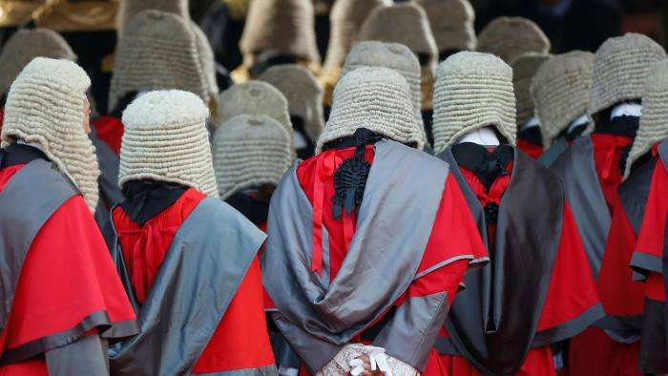
Session 1 Course Introduction / The Legal System of Hong Kong
SSW 409 LEGAL & ETHICAL ASPECTS OF SOCIAL WORK Hong Kong Nang Yan College of Higher Education Bachelor of Social Work (Honours) Programme Second semester 2025-2026
Copyright by Lam Cham Him, Leo

Slide 2
Self-intro
BSW , JD (CUHK)
ISS
IFSC, SWD
FCPSU, SWD
Email: leolam@ny.edu.hk

Slide 3
Objectives
Introduce students to the legal system of Hong Kong and various areas of law likely to be encountered by the service users.
Introduce students to laws and legal principles relevant to the practice, obligations and duties/liabilities of the social workers.
Discuss the interaction between law and ethics in social work.
Help students explore personal values and beliefs and introduce ethical theories and frameworks that can be used to assist decision making.

Slide 4
Deliverables of the Course
Lectures
Group classwork and presentation
Deliverables and Examination
Group presentation (30%)
Individual paper - case analysis (30%) – refer to course outline and scheme of work
Final examination (40%) – open book in long questions

Slide 5
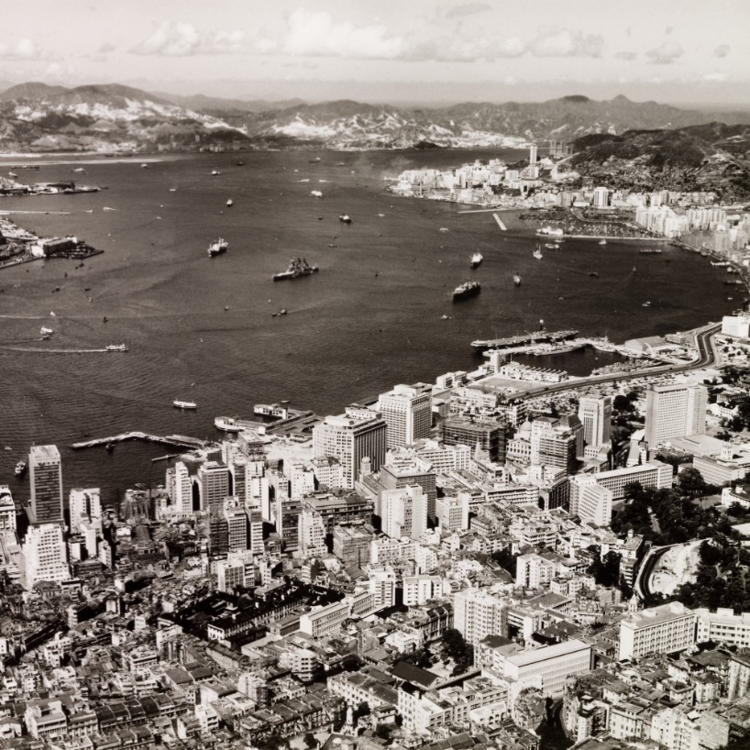
History of Hong Kong
https://www.youtube.com/watch?v=yoCsM3XBiFk&ab_channel=Suibhne

Slide 6
Laws of Hong Kong
The History of HK Law
Law before HK
the First Opium War (1839-1842)
The inhabitant had to manage their own affairs by custom and tradition.

Slide 7
The extension of the common law to Hong Kong originated with two Proclamation of Elliot’s. [1 Feb 1841], provided that the island’s indigenous inhabitants were to be
- Secured in the free exercise of their religious rights, ceremonies and social customs and in the enjoyment of their lawful private property and interest
- And governed, pending Her Majesty’s further pleasure, according to the laws, customs and usages of the Chinese (every description of torture excepted) by the elders of villages, subject to the control of British magistrate.

Slide 8
The second proclamation, of 2 Feb 1841, issued by Elliot alone, provided that:
All British subjects and foreigners residing in, or resorting to the island of HK shall enjoy full security and protection, according to the principle and practice of British law.
Elliot’s Proclamations set up a dual system of law in HK of the day: Chinese customary laws for ethnic Chinese and English common law for persons inbound from the British Isles.

Slide 9
Queen Victoria established the “Island of HK and its Dependencies” as Crown Colony.
London persuaded Peking to lease it the entire landmass and its surrounding islands to the south of the Sham Chun River - for a term of 99 years, known as the Second Convention of Peking.
The region occasionally became chaotic.
The customary land law that emerged from New Territories was substantially inconsistent with the Qing code;

Slide 10
The Crown Colony Constitution
The Crown colony’s constitution was a monarchical one, made in the image of early modern England’s.
The letters Patent, the HK letters Patent of 5 April 1843, which stood the test of time until 1 July 1997, established:
The Governor of Hong Kong:
The Executive Council
The legislative Council
The first principle such as the rule of law and judicial independence

Slide 11
Hong Kong Letters Patent 英王制誥 (香港)
通稱「香港憲章」，是香港英治時期的重要憲制性法律文件，為皇室制誥的一種。
1843年4月5日，為了給予英國政府對香港政府的統治提供指引，英女王維多利亞以英王特權立法的形式頒發《英王制誥》，並於同年6月26日在香港總督府公佈，根據前者，香港成為英國皇家殖民地；
香港殖民地政府和定例局則根據後者成立
其後經過數次重修，最後的版本頒佈於1991年，內容主要確立香港總督的職權、授權設立行政局與定例局（其後改稱立法局），以及各官員的職責等等。
於香港主權移交中華人民共和國後，地位由《香港特別行政區基本法》取代[英王制誥對香港總督的權力，及對行政、立法及司法機關都有非常嚴格的限制，例如按察司的任命或者罷免都必須通過非常嚴格的程序，以維護法官於執行公義的個過程中不會因為行政機關施加壓力而不能夠保持獨立及客觀，以及保持公眾對法院的信心。英王制誥亦為立法機關提供了權力來源的確立，授權港督經諮詢立法局後制定香港法律和法例的全權。立法局制定的法律不能超越制誥所授予的權限或與制誥有所牴觸，否則一律會被法院宣布無效。

Slide 12
Fundamentals of English Common Law
The dual order of English and Chinese law was soon abolished by the Supreme Court Ordinance (No. 15 of 1844).
All matters and questions touching the right or title to any real property in the said colony, the law of England shall prevail and that no law shall be recognized in the said Colony, which shall in any way derogate from the sovereignty of Queen of England
The whole of the laws of England into HK that soon proved and the formula settled on in 1873, with the enactment of the Supreme Court Ordinance (No 12 of 1873), provided in s.5 that: 05 th April 1843 in force in the Colony except some inapplicable to the local circumstance.

Slide 13
The Uniqueness of the HK Law
Founded as a British Crown Colony in 1843 and converted to a Chinese special Administrative region in 1997.
The vast majority is of ethnic Chinese descent, hundreds of thousands of residents belong to the all-area of ethnicities hailing from every inhabited continent
It is the oldest continuously functioning legal system in East Asia

Slide 14
When the Japanese occupied HK (1941-1945) , the same legal system has held sway in territory over course of no less than 170 years after the resumption of sovereignty in 1997 by the People’s Republic of China, which operates a system of law based on Socialist and civilian law principle.
The predominance of common law in HK entails that its legal system shares few of the Continental European civilian law principle and practices of all nearby jurisdiction.
It means the legal system has been before and after the 1 July 1997

Slide 15
1997 to Now - The Basic Law of the HKSAR
The basic law was promulgated by National people’s congress NPC on 04 April 1990, to codify the promises of the People’s Republic of China to conserve the pre-existing institutions and way of life of HK.

Slide 16
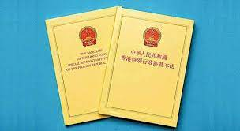
What is Basic Law?
https://www.youtube.com/watch?v=7bV5kK3XuFo&ab_channel=SouthChinaMorningPost

Slide 17
Discussion
What is Common Law?
Which laws or ordinances would be applicable to a social worker?
What are the functions of law ?

Slide 18
Functions of law

Slide 19

Law Maintains peace and order
Criminal offences
Serious offences:
murder and rape
Minor offences:
speeding
careless driving
littering
breaching of MTR’s rules

Slide 20
Law regulates and control human behaviour
Civil Law
Regulates civil juristic acts (民事法律行為) between individuals
Law of contract regulates contractual relationship
Law of Tort regulates civil acts to a reasonable standard
Tax law imposes duty of paying tax
Criminal Law
Control certain activities
Driving – Road Traffic Ordinance
Factory safety
Water pollution

Slide 21
Law sets the social standards
Marriage Ordinance 婚姻條例
Monogamous in nature (一夫一妻制)
Prohibits unions of concubinage (納妾)
Crimes Ordinance 刑事罪行條例
Prohibit male homosexual activities for anyone
under the age of 21

Slide 22

Law promotes changes in social values
Sex Discrimination Ordinance
Prohibit discrimination against pregnancy, gender
and marriage

Slide 23
內地實行的大陸法 (civil/continental law) 法制與香港實行的普通法 (common law) 法制分屬 現今世界兩大法系。
大陸法系源自義大利羅馬，主要在歐洲大陸，如法國、德國，以及日本、南韓等國家／地 區實行。
普通法系源自英國，主要在英國和與英國有歷史關係的國家／地區實行，如美國、加拿大、 澳洲、新西籣、新加坡、馬來西亞、印度等。

Slide 24
Common Law
HK legal system has remained firmly embedded in the common law tradition although her departure from the Commonwealth in 1997.
Decisions of the Court of Final Appeal have been cited with approval by courts of last resort across the common law world
The legal system of HK is no mere clone of the English➔ Reason: It admits Chinese customs in lieu of English ones.
China Field v Appeal Tribunal (Buildings). Mentioned that one of the things which that exception was to leave some room in certain sphere for ethnic Chinese domiciled.
It is nowadays widely recognized that, whilst all common law systems sprang directly or indirectly from England, the common law is no longer monolithic and may differ from one jurisdiction to another.

Slide 25
Common Law
As a source of law and as opposed to statutory law, common law is the body of law derived from judicial (case by case) decisions in the king’s courts (or the Royal courts) in England. Historically the king was the fountainhead of justice. His courts deal with disputes among his subjects. This body of law is called “common” law because it is common to all the king’s courts. It is also called “judge-made law” or “case law”
The common law is used to refer to the case law that judges make through adjudication.

Slide 26
Differences between Common law and Case law
The common law is more than case law. The common law has been understood as the unwritten customary law which had gradually evolved over 1000 years. It lays claim to ancient prescription, ongoing adaptability, correct principle and reason and conformability to society and social consent.
The common law, in short, embodies the inherent social order of a free, just and reasonable community that constantly evolves.
The common law now stands for a set of concepts, interest and values which it has protected during the course of its long history include the rule of law, judicial independence, access to the courts, the separation of powers and the liberty of the individual

Slide 27
Civilian Law
These two are of course not the only influential legal traditions extant: Islamic law, canon law, scandinvian law, socialist law, hindu law also hold sway in various parts of world
The ancient Roman tradition of civilian law was reborn with the revivial of Latin of the eleventh, twelfth and thridteenth centuries in the work of scholars of the new-born “universities of study” who set out to develop a law that would be autonomous from the canon law of the Church but superior in rational malleability to the patchwork of prevailing local custom

Slide 28
兩大法系主要分別:
1. 法律的來源：大陸法系主要依賴成文法法典，例如拿破侖法典、內地今年開始實行的民法 典；而普通法系除成文法外，更重要的是法庭的判例 (judicial precedents) 是法律重要組成 部份。
2. 法庭的角色 :大陸法系的法庭聆訊屬質詢性 (inquisitorial)，法官角色(如在調查證據方面) 較主動；普通法系的法庭聆訊屬對抗性 (adversarial) ，法官角色較被動。
3. 法官的委任：大陸法系的法官屬獨立的專業，畢業後便可擔任；普通法系的法官一般從有 經驗的律師及大律師中委任。 但在全球化趨勢下，兩大法系不斷交流、融合，相似之處越來越多。

Slide 29
Systemic differences between civil and common law persist in spite of certain converges with regard to the use of legislation and precedent
Common Law - It is designed to supplant fundamental common law norms
Civilian Law Jurisdiction - Courts are expected to apply the codified law, is already compendious {easy}, literally and cautiously by default
Common Law - Adversarial, common law entails the adversaries to the case to confront each other with witnesses, evidence and arguments, laid largely unaided before a passive judge-umpire. In Jones v National Coal Board (1957), Denning LJ explained that common law judges do not ‘conduct an investigation or examination on behalf of society at large, as happens, we believe, in some foreign countries.
The law is kept consistent and certain by the principle of “judicial precedent”: decisions of the court in previous cases are followed in later cases until declared wrong by higher courts, and decisions of the higher courts are followed in the lower courts.
Over time, a huge, consistent but fluid body of law, both substantive and procedural, was developed, covering all aspects of legal relationships.

Slide 30
Civilian law - Dispute resolution in the civilian law tends to be inquisitorial- stems from the predilection of French Kings Philip Augustus and Louis IX for employing judge-inquisitors who would proceed under Romano-Canon law to interrogate parties and witnesses privately and separately, prepare a written record that could be exhaustive and only then decide case outcomes

Slide 31
Common Law System vs Civil Law System
Common law systems derive their laws primarily from decided cases (“precedents”), amended, consolidated or explained by legislation where appropriate.
Civil law systems have laws based on written documents (constitutions, codes, statutes, regulations, etc) enacted by an authority (the legislature), which are then applied by the courts.
The modes of litigation in the two law systems are also different - Adversarial System (common law jurisdictions) vs Inquisitorial System (civil law jurisdictions).

Slide 32
The Court System
In Hong Kong, there are the:
Magistrates' Courts;
District Court (including the Family Court);
High Court (comprises the Court of First Instance and the Court of Appeal); and
Court of Final Appeal.
Tribunals. There are also a number of tribunals: (a) Lands Tribunal; (b) Labour Tribunal; (c) Small Claims Tribunal; (d) Obscene Articles Tribunal.
There is also a special court, the Coroner’s Court.
The court system is independent of the executive authorities (the government) and the legislature.

Slide 33
How to Read a Case
Anatomy of a Case Report:
a. Case title and citation - parties, level of court (first instance or appeal);
b. Case summary;
c. Discussions and judgment:
Facts of the dispute - What was the dispute that took a plaintiff to court (What happened)? Why did the defendant not agree to satisfy the plaintiff’s demand (What was his defence)? What did the plaintiff want to achieve (get monetary compensation / get a declaration and some form of injunction)? If the case is an appeal, what caused the appellant to appeal? Think this way: What happened from the real world to the court, from the trial court to the CA, from the CA to the FCA, from the CFA to final disposal;
Parties’ arguments - This usually is legal in nature such as what legal principles should be applied to the facts; why certain principles should apply and not others; why certain precedents should be followed or distinguished?

Slide 34
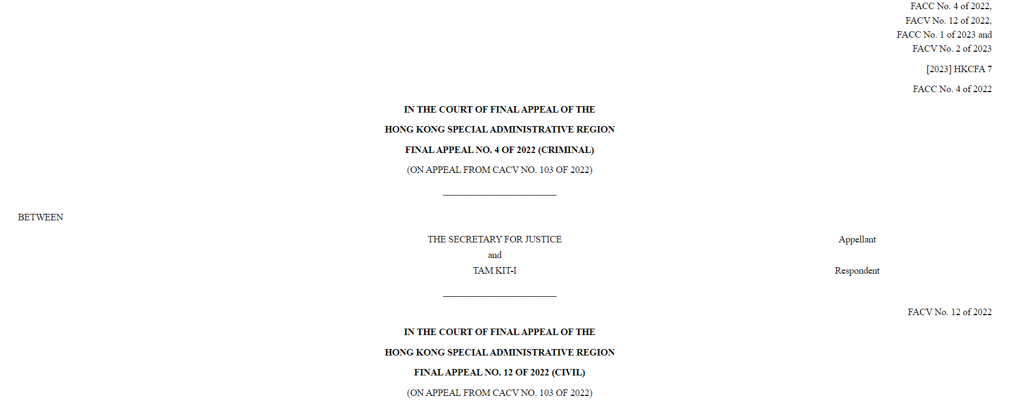

Slide 35
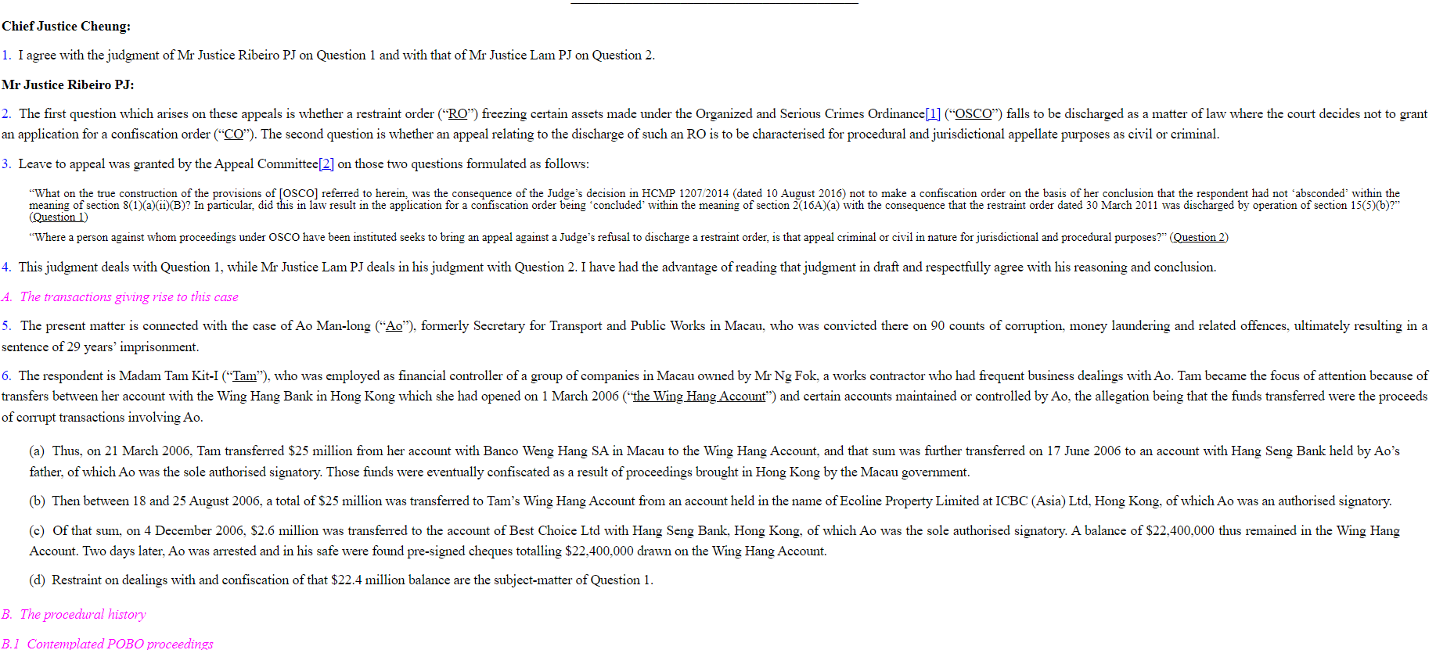

Slide 36
The judge’s reasoning, which normally consists of the following parts:
A summary of material facts;
Response to parties’ arguments;
Legal principles found to be applicable to the facts of the case;
Application of those principles;
Decision.

Slide 37
The written judgment could be very long and complicated. However, only certain parts of it forms the final legal principle that determines the dispute between the parties (or the legal question in issue). The rest are just discussions, thinking processes, or comments. From this angle, a judgment consists of the following two categories of materials:
Ratio decidendi (reason for the decision) - a statement of facts and of the applicable legal reasoning and principles that are crucial to the reaching of the decision as applied to the specific facts of the case; binding; and
Comments on the law that are not crucial to the decision - obiter dictum/dicta (saying by the way or in the passing). These comments are not binding but persuasive.
Remedies, quantum and disposal of other matters

Slide 38
What’s inside a judgment ?
Facts of the case
Both sides arguments
Held (ruling)
Ratio decidendi (判決理由)
Obiter dicta (附帶意見)

Slide 39
Doctrine of Stare Decisis
Let the decision stand
Doctrine of judicial precedent
Ration decidendi of a superior court bind the inferior courts
when they deal with subsequent cases raising similar issues
How to distinguish a case?
E.g. a binding precedent from CFA (Case A)
Set out legal principle
But it will not apply to other case if:-
The fact of other case is different to that of Case A
The principle of Case A should not bind me

Slide 40
Doctrine of Stare Decisis
Law reports (案例報告) collected all the decisions
Unreported judgments ⇨ official websites of courts

Slide 41
The Legal Profession
Barristers and the Hong Kong Bar Association.
Solicitors and the Hong Kong Law Society.
In the common law system, judges are not a separate profession. Judges are senior and well-regarded lawyers who, after a course of practice as lawyers, become appointed as judges.

Slide 42

Legal Aid Service
The Legal Aid Department (“LAD”)
Provides legal representation in civil and criminal cases to applicants. Applicants have to satisfy a means test (that they are financially eligible for assistance) and a merits test (that there is justification for legal representation). Once granted legal aid, a case will be assigned to a member of the LAD’s Litigation Division or to a lawyer in private practice with the relevant expertise.

Slide 43
Legal Aid in Criminal Cases
Legal aid is available for cases heard in the District Court, the CFI, the CA and the CFA. It is also available in the Magistrate’s Court for ‘committal proceedings” in respect of more serious cases. For other cases heard in the Magistrates’ Court, free legal assistance is provided by the Duty Lawyer Scheme.
Means Test
An accused will be eligible if his/her financial resources do not exceed HK$420,400. Where this financial eligibility limit is exceeded, the Director of Legal Aid may waive the limit if he is satisfied that it is in the interests of justice to do so in meritorious cases (eg., cases in which a breach of the Hong Kong Bill of Rights Ordinance or an inconsistency with the International Covenant on Civil and Political Rights is an issue) and provide service subject to the accused paying a contribution of the legal fees.

Slide 44
Merits Test
For trials in the District Court and the CFI, legal aid will be granted if it is desirable in the interests of justice to do so. (In practice, all cases where the means test is satisfied receive legal aid with or without the applicants’ contribution.)
For appeal cases, legal aid will be granted if there are reasonable grounds for appeal and it is in the interests of justice to do so.

Slide 45
Legal Aid in Civil Case
Legal aid may be granted to litigants in all civil proceedings except defamation actions, Small Claim Tribunal and Labour Tribunal matters and actions involving derivatives, securities or futures (except in cases where fraud, misrepresentation or deception are alleged in the sale of those products). An applicant has to make a statement about his/her case to the LAD, which will then be passed on to a lawyer for evaluation.
Means test - same as the means test in criminal cases, but an applicant whose means exceeds the financial limit will automatically be precluded from receiving legal aid (with very limited exceptions).
Merit test - this test is far more significant than the one in criminal cases. The applicant needs to have reasonable grounds for bringing or defending the case and a reasonable prospect of success or at least a reasonable chance of deriving some tangible benefits from receiving legal representation (eg, there is not a negligible amount to be recovered or an important point of principle is involved) .

Slide 46

The Duty Lawyer Scheme
The Duty Lawyer Scheme is administered by the Duty Lawyer Service, funded entirely by the government, incorporated as a company, and managed jointly by the Hong Kong Bar Association and the Hong Kong Law Society.
The Scheme offers legal representation to defendants in the Magistrates’ Courts and the Juvenile Courts in almost all cases, and to subjects in Care and Protection Proceedings. Defendants wishing to be represented under the Scheme approaches the Liaison Office for the Magistrates’ Court in which his/her case is dealt with.
Means test - for defendants in the Magistrates’ Courts, the financial eligibility limit is set at a gross annual income of $216,500. (Updated at Jan 2023) There is no means test for defendants in the Juvenile Courts and those subject to Care and Protection Proceedings.
Merits test - representation is given where it is in the interest of justice to allow the applicant access to the Scheme.

Slide 47
「當值律師計劃」為於裁判法院和少年法庭受刑事審訊的被告提供律師，代表他們進行訴訟。所有律師均是合資格的私人執業律師和大律師。有關服務包括﹕
就被告應否認罪提供意見；
如果被告認罪，則代表被告求情；
如果被告否認控罪，則於審訊時替其辯護；以及
當被告於審訊後被判罪名成立時，替其求情。
其他服務﹕「當值律師計劃」同時為以下人士提供律師進行訴訟：（1）在死因聆訊中，因提供對自己不利的證據而可能面臨刑事起訴的人士；（2）被拒發小販牌照而向文康市政上訴委員會提出上訴的小販；（3）面臨引渡程序訴訟的合資格人士。

Slide 48
Why will have Duty Lawyer Service?

Slide 49
1. Social Workers Registration Ordinance (Cap 505)
2. Department of Justice Website (http://www.doj.gov.hk/eng/ind ex.html)
3. Code of Practice for Registered Social Workers

